Slide 1
RESEARCH PRESENTATION By Muhammad Imran

Slide 2
RESEARCH TOPIC
Climate change impact on storm water runoff quantity and quality for changing climate and urbanization

Slide 3
PROBLEM STATEMENT
With future growth in population and climatic trends, how this will impact urban storm runoff?

Slide 4
LITERATURE REVIEW
The impacts of climate change and urbanization on drainage in Helsingborg, Sweden: CSO System
Two climate scenarios (B2/A2)
Delta change method for GCM to RCM conversion
Baseline scenario (19610 – 1990) and future scenario (2071 – 2100) with 6 hours temporal resolution
Three urbanization trends (current situation with population increase, disconnection of storm water and water demand reduction)
Increase in population will increase overflow volumes and nutrient load
Use of SUDS and storm disconnection will reduce the overflow volume and nutrient loading
Notes:
Future precipitation simulation resulted in increase in rainfall volume due to increase in frequency not the intensities

Slide 5
LITERATURE REVIEW
Analysis of climate change effects on urban runoff – M. Jung 2015
Study area 85% impervious
Landuse (residential, commercial, institutional, public areas and school)
Linear regression analysis was used to extrapolate collected data for future climate scenarios
Runoff simulation done for 10 year and 100 year return period, rainfall duration (10min, 1 hour), base year 1975 and forecast years of 2020-50
Flow routing done using dynamic wave method and SCS curve method was used for infiltration
Modelled peak discharge and runoff volume for all durations and return period increases
Notes:
Future scenarios have higher runoff values than baseline model
Short duration scenario have greatest increase in peak discharge and runoff volume

Slide 6
LITERATURE REVIEW
Assessment of LID for managing storm water with changing climate
Study area 85% impervious
Landuse (residential, commercial, institutional, public areas and school)
Linear regression analysis was used to extrapolate collected data for future climate scenarios
Runoff simulation done for 10 year and 100 year return period, rainfall duration (10min, 1 hour), base year 1975 and forecast years of 2020-50
Flow routing done using dynamic wave method and SCS curve method was used for infiltration
Modelled peak discharge and runoff volume for all durations and return period increases
Notes:
Future scenarios have higher runoff values than baseline model
Short duration scenario have greatest increase in peak discharge and runoff volume

Slide 7
LITERATURE REVIEW
Assessment of LID for managing storm water with changing climate
Study area 85% impervious
Landuse (residential, commercial, institutional, public areas and school)
Linear regression analysis was used to extrapolate collected data for future climate scenarios
Runoff simulation done for 10 year and 100 year return period, rainfall duration (10min, 1 hour), base year 1975 and forecast years of 2020-50
Flow routing done using dynamic wave method and SCS curve method was used for infiltration
Modelled peak discharge and runoff volume for all durations and return period increases

Slide 8
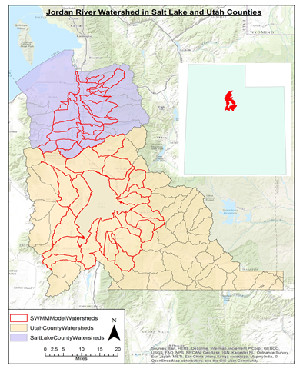
STUDY AREA
Study area is located in Salt Lake and Utah county
Study the storm runoff into Utah Lake and Jordan River
For SWMM model development those watersheds were selected which had higher urban population

Slide 9
METHODOLOGY
Two modeling scenarios (Present and Future)
Land use development
Climatic trends
Watershed delineation
SWMM input parameters estimation
Precipitation data collection
Storm water pollutant loading
Model calibration
Notes:
Design storm and continuous modeling

Slide 10
METHODOLOGY
Sub-catchment delineation based on following land use types;
Residential (Single/Multi-Family)
Commercial and Instituitional
Green barren and open green
Water
SWMM input parameters
Percent impervious
Roughness
Depression storage
Infiltration - Curve number

Slide 11
METHODOLOGY
Parameters estimation
Land use
Land cover
Soil type
Approach – Area weighted average
Climate Data

Slide 12
THANKS!

